Slide 1
TSMC Multi-Bit RRAM Macro: Multi-Bit Design Ideas
Akash Levy
3/30/2021

Slide 2
High-Level Architecture
Array Controller
Control Logic Unit (CLU)
DACs
RRAM Array
ADCs
VWL
VBL/
VSL
BYP?
BYP?
Mux+
Ctrl
READ Data

Slide 3
From Last Time: Single-Phase Operation
Parameter Register File
Level | BL Start DAC Level | BL Stop DAC Level? | BL DAC Step Size | SL Start DAC Level | SL Stop DAC Level | SL DAC Step Size | WL Stuff… (x3 cols) | Flags (for loop order)
0
1
2
3
…
63
64 (?)
Select parameters for target level
Sequentially go through levels, mask bits, apply pulses

Slide 4
RRAM Array Internals
RRAM Array
512 WL
x
1536 BL
(Array_0)
RRAM Array
512 WL
x
1536 BL
(Array_1)
Total cells: 3145728 ~ 3M Cell
Interface will be similar to TSMC RRAM macro’s:
44-bit → 64-bit interface
No ECC, if needed, must be done at software-level
NOTE: Skywater RRAM had 16-bit interface
XADR[9:0] for WL
YADR[5:0] for BL
DIN[3:0][63:0], DOUT [3:0][63:0]
Allows up to 4 words at once
RDONE (async ready)
2bpc: 6Mbit, 3bpc: 9Mbit, 4bpc: 12Mbit
WLDRV
BLDRV/SLDRV
RRAM Array
512 WL
x
1536 BL
(Array_2)
RRAM Array
512 WL
x
1536 BL
(Array_3)
WLDRV

Slide 5
RRAM Array Internals
RRAM Array
512 WL
x
1536 BL
(Array_0)
RRAM Array
512 WL
x
1536 BL
(Array_1)
Some bitlines will be reserved for configuration, these will only operate in single-bit mode
Will be stored at the end of Array_1 and Array_3
Do we want some sort of redundancy for these bits?
If misconfigured, array may not be able to be programmed properly!
But maybe not an issue for our prototype, because we can just configure the registers from off-chip if there is a problem
Programming interface for these bits? Or just configure in manual mode?
1536 = 1024+512
WLDRV
BLDRV/SLDRV
RRAM Array
512 WL
x
1536 BL
(Array_2)
RRAM Array
512 WL
x
1536 BL
(Array_3)
WLDRV

Slide 6
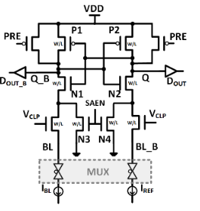
Sense Amp
Will continue to use similar design to prior Skywater tapeout
Compact latch-based SA
Sequential access won’t matter
Clamp READ voltage on BLs
With BL programming DAC?
Compare BL current against programmable current reference
Current reference will be common across all SAs
Common voltage clamp as well
Process variation problems?
Prof. Horowitz had area-reduction suggestions on previous design…
Sense amp will probably also need to be multiplexed to trade off area with speed... how this is done will be based on area estimates and floorplan constraints

Slide 7
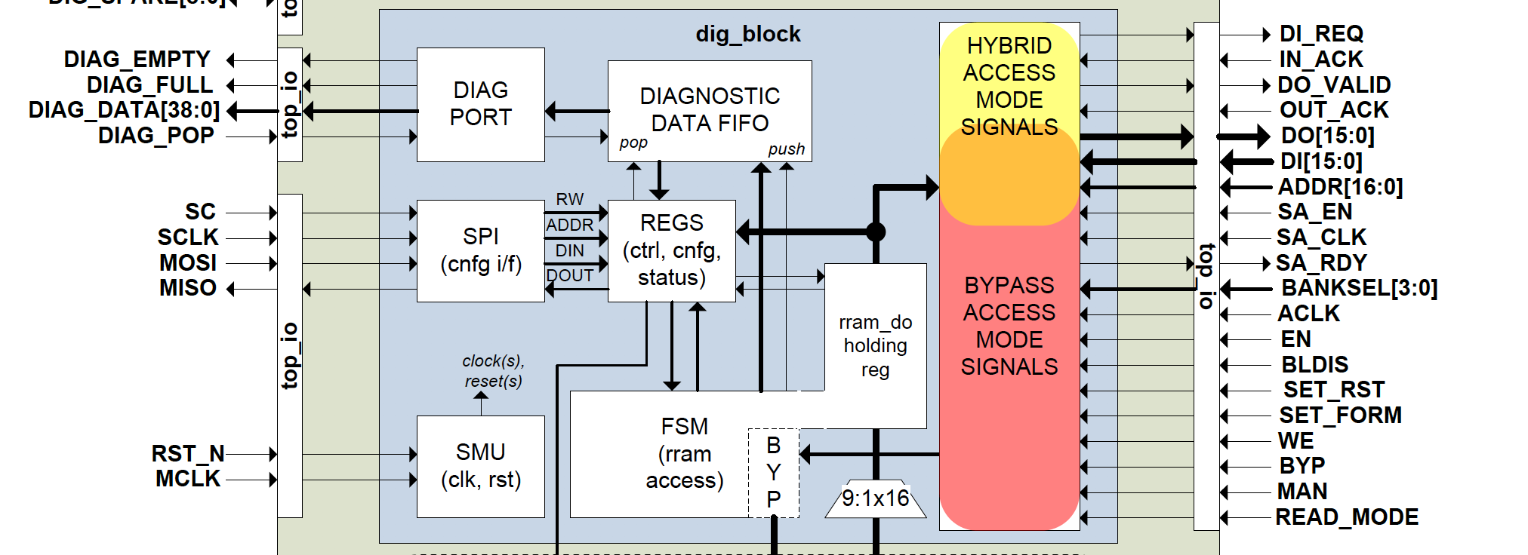
Digital Block
Should be very similar to Skywater design FSM
Modes: Bypass, Manual, Digital, (Hybrid?)
Bypass will simply switch an analog mux to enable off-chip array access via bypass ports
Manual mode will allow off-chip control of the arrays via SPI
Digital mode will use an FSM to allow program/read operation as black box

Slide 8
High-Level Programming Approach
Blanket RESET (if enabled)
Do until give up:
For range i between 0…2^bpc-1 (in decreasing order):
Set upper bound current reference for range i
Mask bits that are above range i
Start applying SET pulse
Counter counts up to PW (clk_freq. * cycles)
Stop applying pulse
WL++/BL++ depending on settings
Verify with ADC and mask bits that are below current reference
For range i between 0…2^bpc (in increasing order):
Set lower bound current reference for range i
Mask bits that are below range i
Start applying RESET pulse
Counter counts up to PW (clk_freq. * cycles)
Stop applying pulse
WL++/SL++ depending on settings
Verify with ADC and mask bits that are above current reference
Freq
11
00
01
10
R

Slide 9
High-Level Readout Approach
Sequentially set current reference to different values and capture
Readout errors due to noise/variation? Best way to correct for these?
Re-read? Register each capture and use bubble error correction?
Freq
>
>
<
Freq
>
<
<
Freq
<
<
<
11
11
11
00
01
10
00
01
10
00
01
10
R
R
R
Freq
<
>
<
???
11
00
01
10
R

